Slide 1

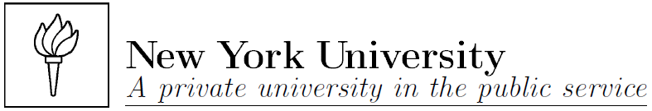
Courant Institute and Department of Biology
Alex Mogilner
Continuous modeling in cell biology
Porquerolles, October 2016

Slide 2
To students and postdocs:
We will use matlab for projects. If you never used it before, attached is a very cryptic intro; practice a little before the workshop, but we’ll
help you at the workshop. We’ll be learning how to use scaling, and also Partial Differential Equations. It’ll help if you read the attached
file ‘Logan’ before the workshop, but not to worry if it’ll be too hard, we’ll explain everything. Below are the slides for the lectures.
We will go over case studies based on these research papers and analyze models and experiments there:
Reverse engineering of force integration during mitosis in the Drosophila embryo.
Wollman R, Civelekoglu-Scholey G, Scholey JM, Mogilner A.
Mol Syst Biol. 2008;4:195.
Doncic A, Ben-Jacob E, Barkai N.
Evaluating putative mechanisms of the mitotic spindle checkpoint.
Proc Natl Acad Sci U S A. 2005 May 3;102(18):6332-7.
Balance between cell-substrate adhesion and myosin contraction determines the frequency of motility initiation in fish keratocytes.
Barnhart E, Lee KC, Allen GM, Theriot JA, Mogilner A.
Proc Natl Acad Sci U S A. 2015 Apr 21;112(16):5045-50.
Yeast kinesin-8 depolymerizes microtubules in a length-dependent manner.
Varga V, Helenius J, Tanaka K, Hyman AA, Tanaka TU, Howard J.
Nat Cell Biol. 2006 Sep;8(9):957-62.
Devore, J.J., G.W. Conrad, and R. Rappaport. 1989. A model for astral stimulation of cytokinesis in animal cells.
The Journal of cell biology. 109:2225-2232.
Odell, G.M., and V.E. Foe. 2008. An agent-based model contrasts opposite effects of dynamic and stable microtubules on
cleavage furrow positioning. J. Cell Biol. 183:471-483.
We will use ideas from 3 reviews about modeling in cell biology:
Cell polarity: quantitative modeling as a tool in cell biology.
Mogilner A, Allard J, Wollman R.
Science. 2012 Apr 13;336(6078):175-9.
Quantitative modeling in cell biology: what is it good for?
Mogilner A, Wollman R, Marshall WF.
Dev Cell. 2006 Sep;11(3):279-87.
Plus, attached manuscript on modeling cleavage furrow positioning

Slide 3
Modeling process:
Think about the data; is there a question that could benefit from modeling?
Formulate hypotheses
Decide on the modeling method and analytics/code/software
Equations, variables, parameters, algorithms
‘Qualitative’ analysis, scaling, non-dimensionalization
Numerical solutions, simulations
Thinking about the results and modifying the model
Writing a paper

Slide 4
A Simple Mathematical Model Can Be Used as
a Quantitative Hypothesis to Be Tested in Future
Experiments or Can Simply Be Thought Provoking
A Model Can Be a Tool for Data Interpretation
Models as Tools for Data Integration and Understanding
Increasingly Complex Generations of Models Can Be
Used to Understand Cellular Networks as Systems
Computer Experiments Can Confirm the Plausibility
of a Qualitative Model or Explore a Complex
Phenomenon When There Is Little Intuition about It
Model can falsify a hypothesis
Model can show which pathways and feedbacks are essential and which are not

Slide 5
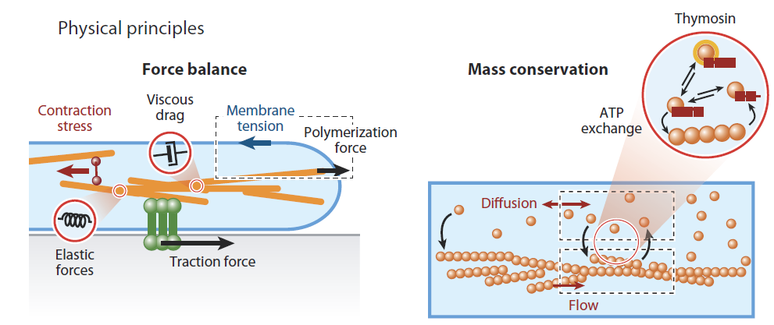
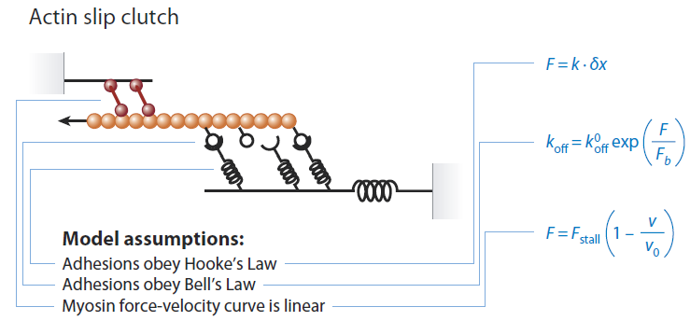
What goes into the model:

Slide 6
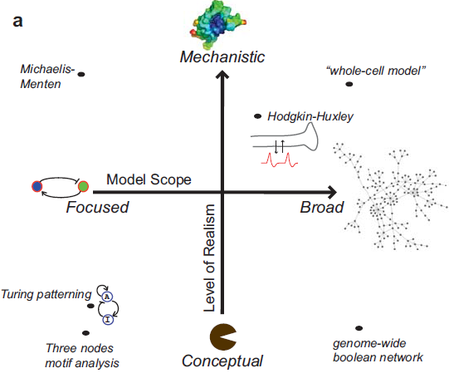

Slide 7
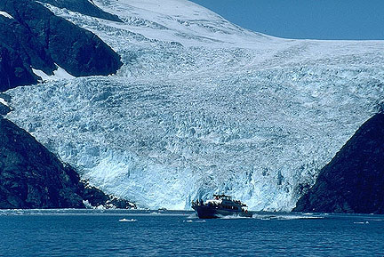
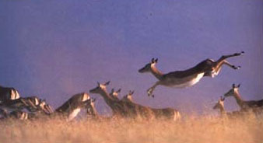
1. List variables, parameters and their dimensions.
2. Decide what are the characteristic scales for all variables.
Scaling means guessing what are the natural dimensional values of the variables that would be observed
(not unique choice). It means finding ‘special’ values that have biological meaning.
Reasons:
For computer
Insight
To scan parameter space
One of the ideas how to do it: simplicity.
Look for parameters with needed dimensions
and make them scales.
3. Non-dimensionalization.
Substitute new variables into eqs and initial/boundary conditions.
4. Think about the meaning of non-dimensional parameters.
5. Solve, often using perturbation theory or numerical analysis.
6. Go back to dimensional variables and thinking about biological meaning.

Slide 8
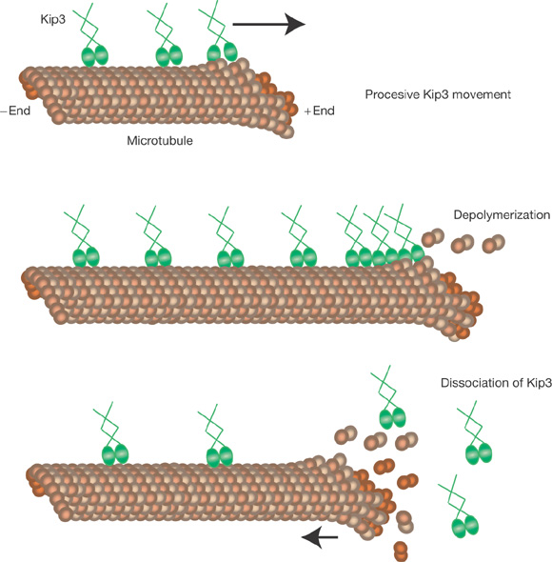
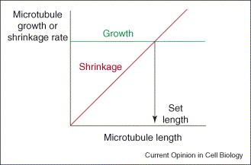
How is polymer length regulated in cells? One of the ways is to use a persistent molecular
motor that gets on a MT from the cytoplasm and travels to the MT plus end. At the
MT tip, the motor accelerates shrinkage (disassembly). The result is:
the longer the MT is, the more motors accumulate at the tip,
the faster the shrinkage is.
Why?
Varga V, Helenius J, Tanaka K, Hyman AA, Tanaka TU, Howard J.
Yeast kinesin-8 depolymerizes microtubules in a length-dependent manner.
Nat Cell Biol. 2006 Sep;8(9):957-62.

Slide 9
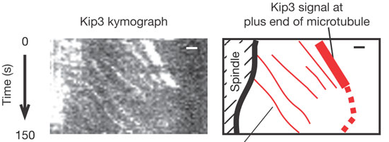
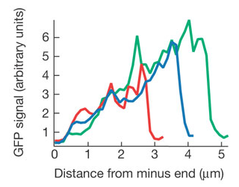
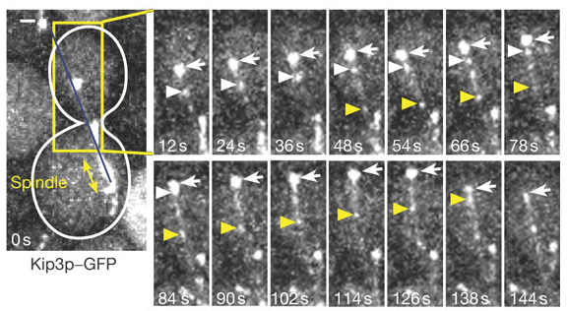
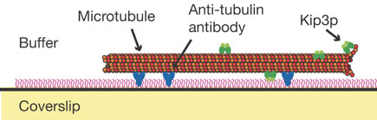
Experiment and observations of Varga et al:

Slide 10

What processes could contribute to motor distribution along the MT length?
association
Arrival to and
dissociation
from the tip
drift
- drift equation
- association equation
Minus corresponds to the right direction.
Solution to is
Solution to is

Slide 11
Reaction-drift model:
Speed, μm / s
Concentration, # / μm
association (source) s
drift V
x
0
L
Time, s
Distance, μm
Source, # / μm⋅s
C,X – variables
V,S,L – parameters
Steady:
L – scale of length
S⋅(L/V) – scale of concentration
x = X/L
c = CV/(S⋅L)
- no parameters!
What is the boundary condition?
We need just one. For the drift equation,
the rule is – it has to be at the boundary
from which the flux goes
In our case, c(0)=0
(motors leave the minus end
to the right immediately)

Slide 12
Slope independent of L, and
so concentration at the tip ~ L

Slide 13
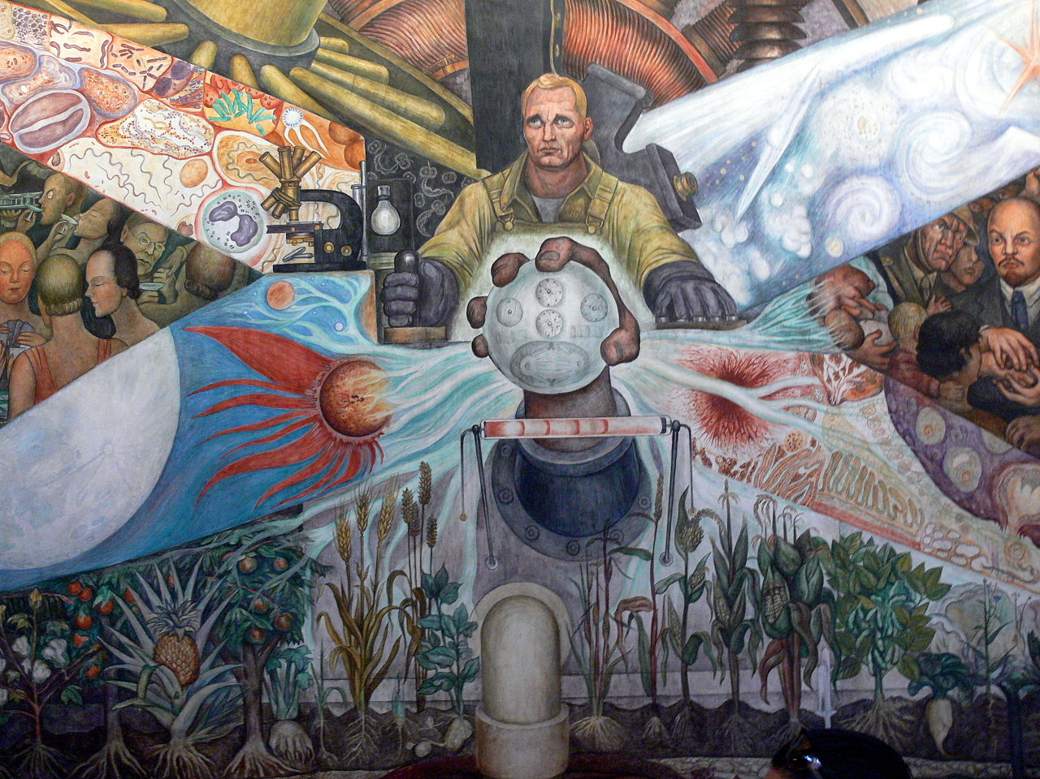
Fragment of Diego Riviera’s mural ‘Man at Crossroads’

Slide 14
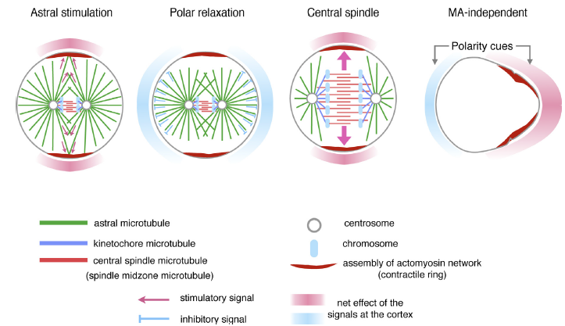

Slide 15
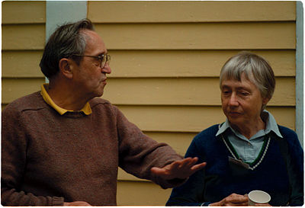
Ray Rappaport (1922 – 2010)
"When I began working on cytokinesis, I thought I was tinkering with a
beautifully made Swiss watch, but what I was really working on was an
old Maine fishing boat engine: overbuilt, inefficient, never-failed and
repaired by simple measures."

Slide 16
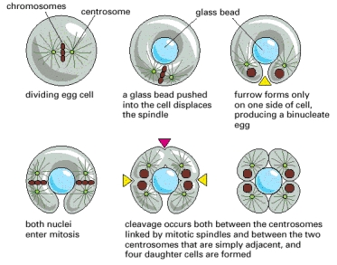
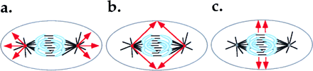
Classic experiment by Raymond Rappaport in sand dollar eggs
Rappaport R (1961) J Exp Zool 148:81–89.

Slide 17
On the mechanisms of cytokinesis in animal cells.
White JG, Borisy GG.
J Theor Biol. 1983 Mar 21;101(2):289-316.
Devore, J.J., G.W. Conrad, and R. Rappaport. 1989.
A model for astral stimulation of cytokinesis in animal cells.
J Cell Biol. 109:2225-2232.
Harris, A.K., and S.L. Gewalt. 1989.
Simulation testing of mechanisms for inducing
the formation of the contractile ring in cytokinesis.
J. Cell Biol. 109:2215-2223.
Canman, J.C., L.A. Cameron, P.S. Maddox, A. Straight, J.S. Tirnauer,
T.J. Mitchison, G. Fang, T.M. Kapoor, and E.D. Salmon. 2003.
Determining the position of the cell division plane.
Nature. 424:1074-1078.
Odell, G.M., and V.E. Foe. 2008.
An agent-based model contrasts opposite effects of
dynamic and stable microtubules on cleavage furrow positioning.
J. Cell Biol. 183:471-483.

Slide 18
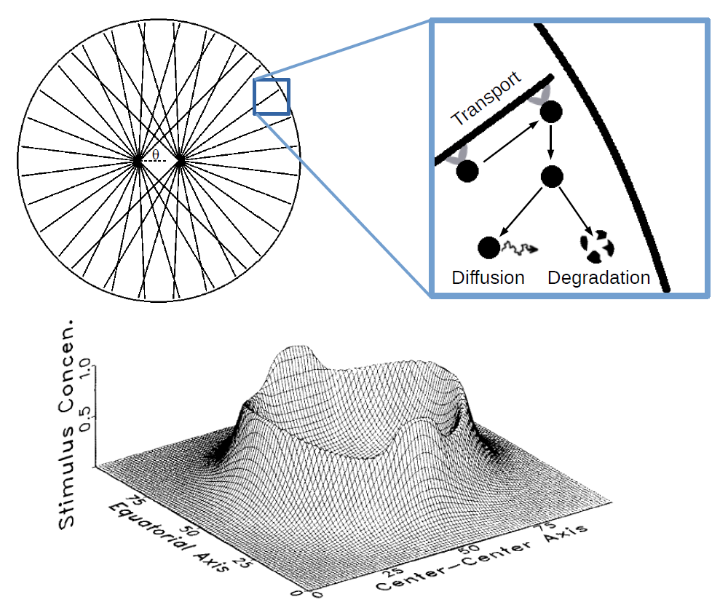

Slide 19
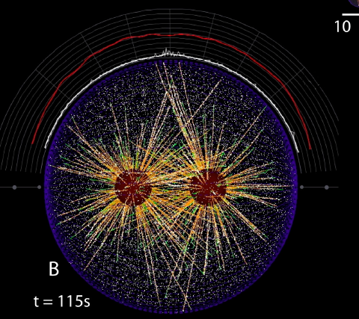

Slide 20
AB models - in silico reconstitutions of biological systems - produce a life-like simulation of the cellular subsystem. T
he AB model allows computer experiments with in silico system, with an exquisite control of all parameters and easiness of simulating
biochemically or genetically perturbed system.
As biological systems do actually consist of a large number of agents, whose simple interaction rules produce mind-bogglingly complex
behavior, AB philosophy is very close to biology, and so often fewer approximations have to be made to build an AB model.
Often, an AB model is much simpler than a DE model, especially in cases where complex geometries, a high number of dimensions
(including, besides spatial dimensions, distributions in angle and size), heterogeneity and anisotropy, and a great number of types of agents
are involved.
AB models capture stochastic effects more naturally than stochastic DE models. When a biological system consists of few discrete objects,
the continuous approximation required for a DE models is not faithful.
Computer-savvy and quantitative-minded biologists can do AB modeling without the need to study mathematics.
The main problem with AB models is that it is often much harder than with DE models to get a qualitative insight: in silico systems tend to
become too complex; in a way, we get interesting results but can only guess how the assumptions lead to those results.
Fewer methods and software exist for AB models.
There are some artifacts inherent to some types of AB models, for example, there are artificial oscillatory solutions in Boolean models and
difference equations that do not correspond to reality.
There are no analytical solutions to AB models, no benchmark cases.
Usually, multiple simulations and vast and nontrivial statistics are necessary to extract meaningful insight from an AB model.
It is usually hard to explore parameter space with AB models.
AB modeling is hard to teach – unlike DEs, to which many textbooks are devoted, descriptions of AB modeling tools are scattered and not
systematized.

Slide 21
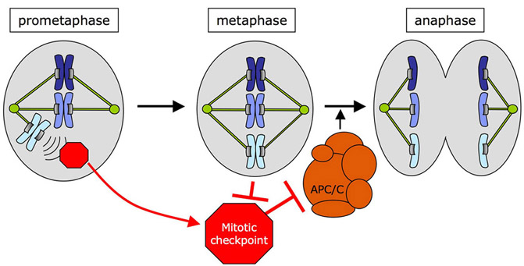
Mitotic checkpoint
Checkpoint mechanisms like those just described tend to act through negative intracellular signals that arrest the cell cycle, rather than through the removal of
positive signals that normally stimulate cell-cycle progression. Consider, for example, the checkpoint that monitors the attachment of chromosomes to the
mitotic spindle. If a cell proceeds into anaphase and starts to segregate its chromosomes into separate daughter cells before all chromosomes are appropriately
attached, one daughter receives an incomplete chromosome set, while the other daughter receives a surplus. The cell therefore needs to be able to detect the
attachment of the last unattached chromosome to the microtubules of the spindle. In a cell with many chromosomes, if each chromosome sends a positive signal
to the cell-cycle control system once it is attached, the attachment of the last chromosome will be hard to detect, as it will be signaled by only a small fractional
change in the total intensity of the “go” signal. On the other hand, if each unattached chromosome sends a negative signal to inhibit progress through the cell cycle,
the attachment of the last chromosome will be easily detected because it will cause a change from some “stop” signal to none.

Slide 22
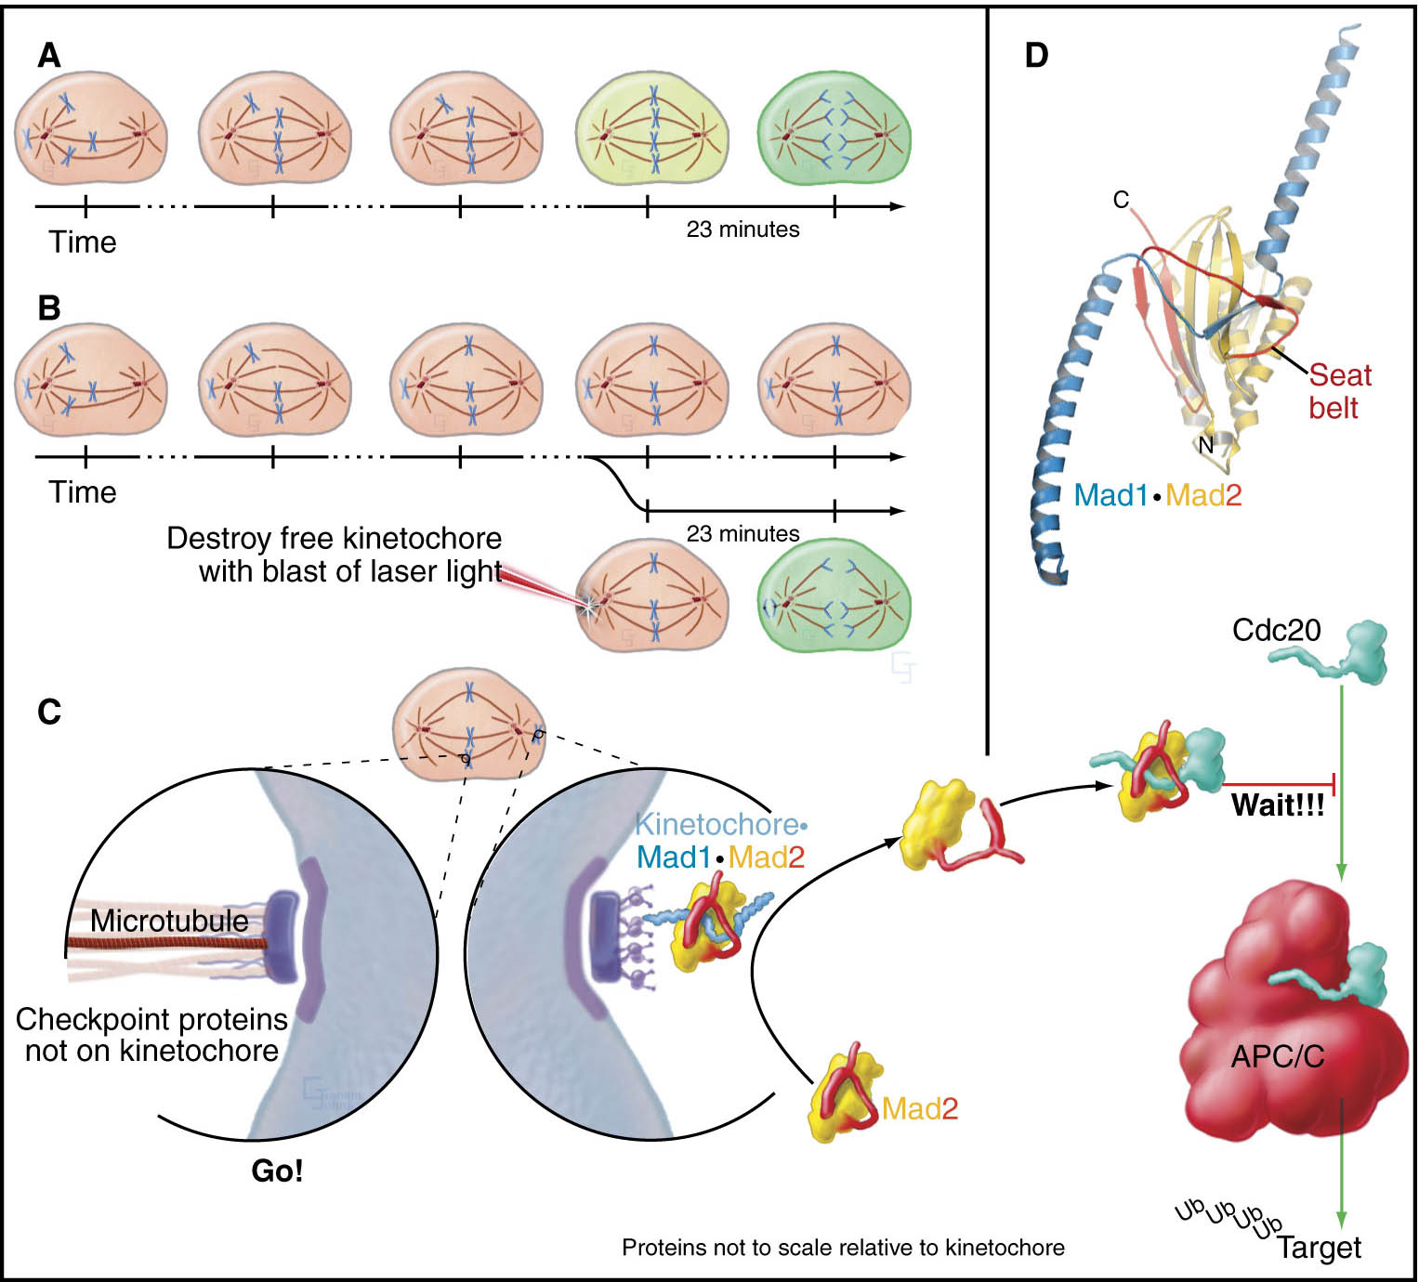
The spindle checkpoint

Slide 23
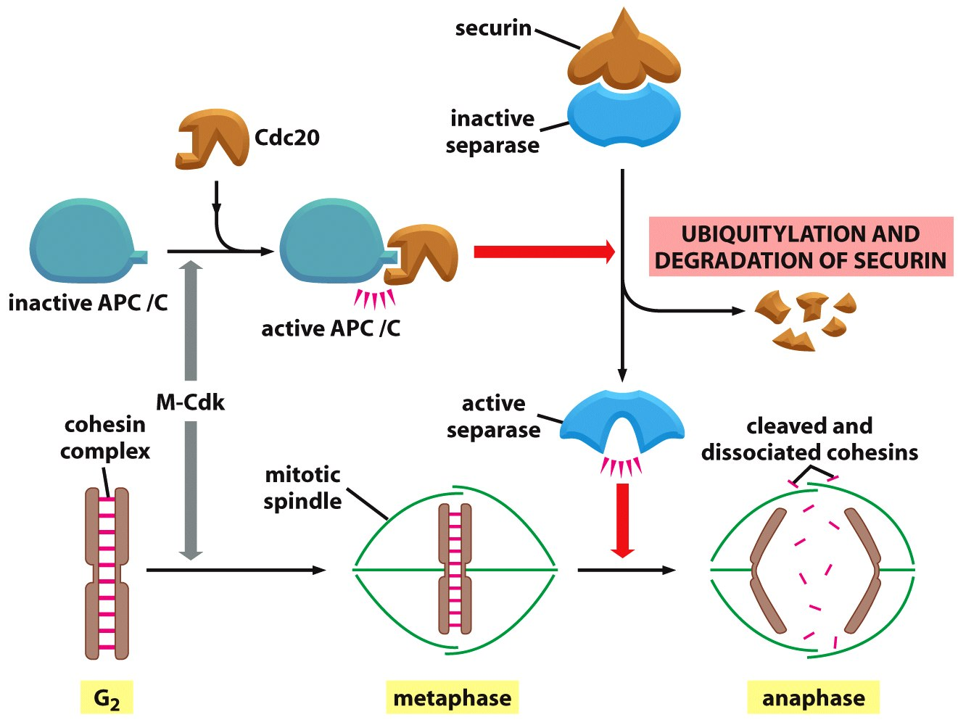
The APC/C triggers sister-chromatid separation and the
completion of mitosis

Slide 24
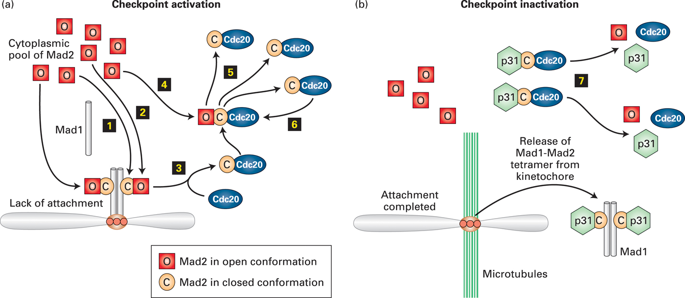

Slide 25
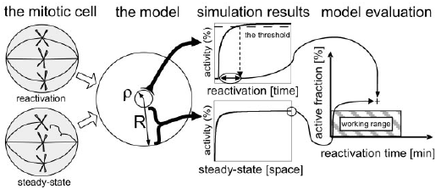
Mitotic checkpoint.
The following two papers examined two central requirements:
capacity of single kinetochore to maintain tight inhibition of the APC–Cdc20 complex throughout the nucleus,
the rapid removal of this inhibition once the final kinetochore is attached
Yeast cell: mitosis
in the nucleus
Doncic et al PNAS 102 6332 2005

Slide 26
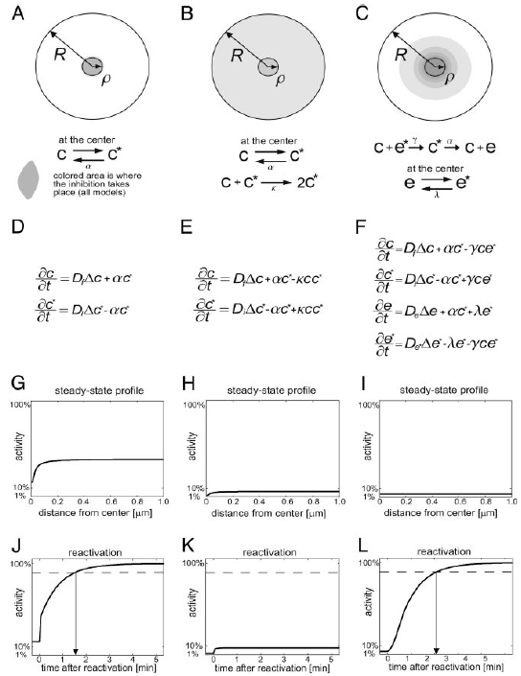
Direct Self-Propagating Emitted
Inhibition Inhibition Inhibition
Doncic et al PNAS 102 6332 2005

Slide 27
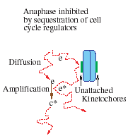
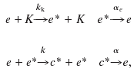
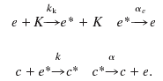
Small yeast; big animal cells
nonautocatalytic amplification
Doncic’s scheme does not catalytically amplify the inhibitory
signal. One e* molecule can interact with only one c
molecule. In Sear’s scheme, a single e* molecule can
convert many molecules
into the inhibiting form, thereby producing amplification.
Sear and Howard PNAS 103 16763 2006

Slide 28
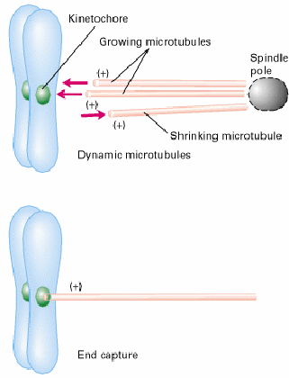
Microtubule dynamic instability and search and capture hypothesis
Search
First math model:
Holy & Leibler, 1994
Capture
Mitchison & Kirschner, 1984-86

Slide 29
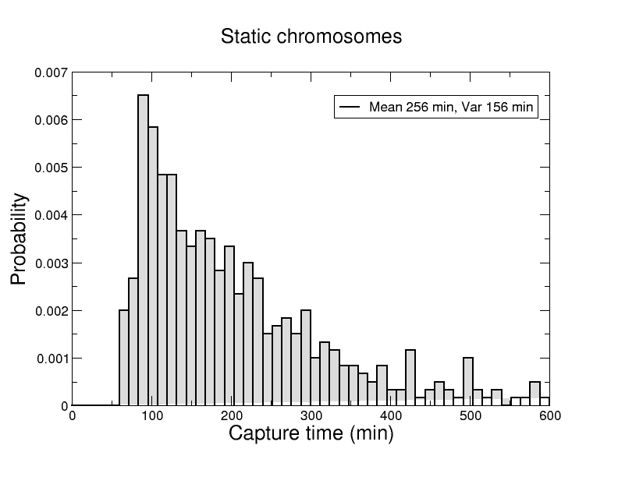
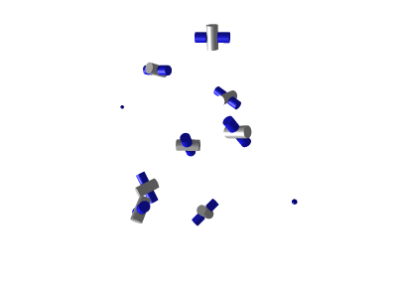
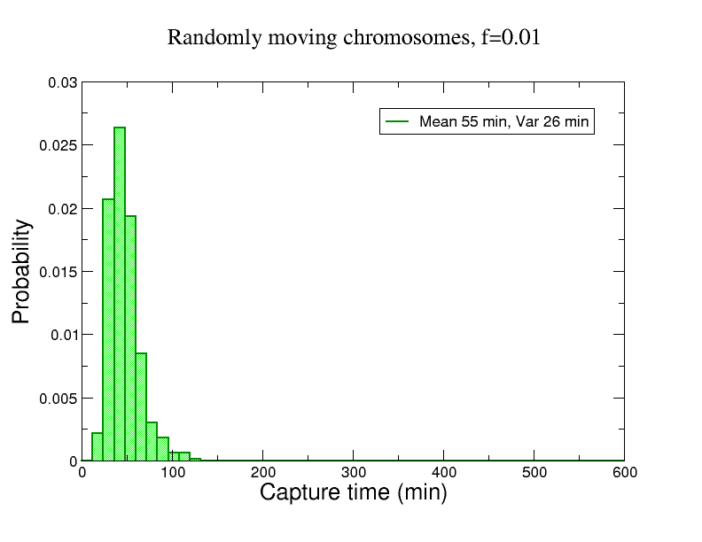
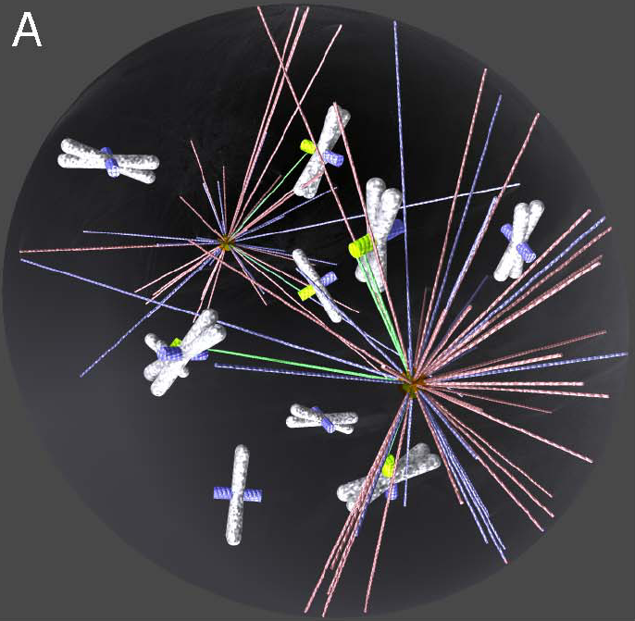
However, for many MTs and KTs, random ‘Search and Capture’ is not fast enough
Wollman et al. Current Biology 15: 828-832 (2005)
Paul et al, PNAS, 106: 15708-1513 (2009)
still not fast enough …
Notes:
29

Slide 30
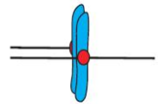
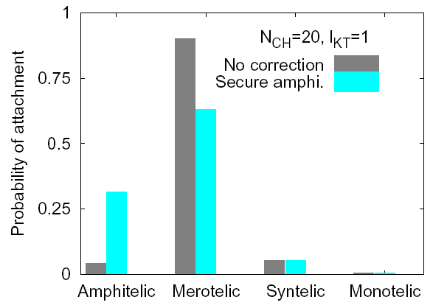
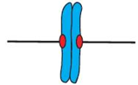
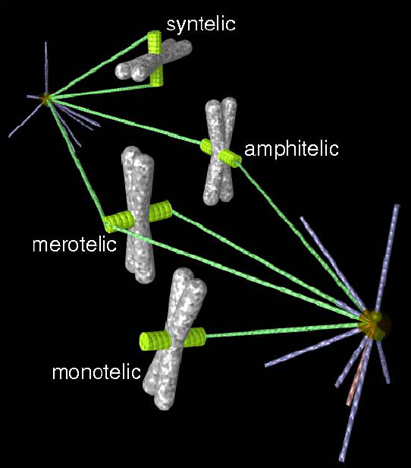
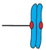
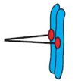
Problem of accuracy
Model simulation shows shocking number of errors:
too many syntelic attachments in the beginning;they turn into the merotelic ones later
Notes:
30

Slide 31
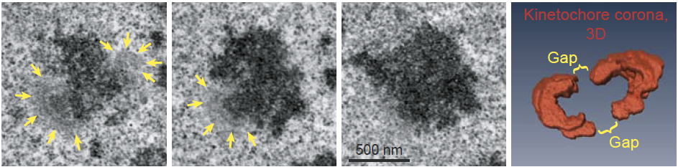
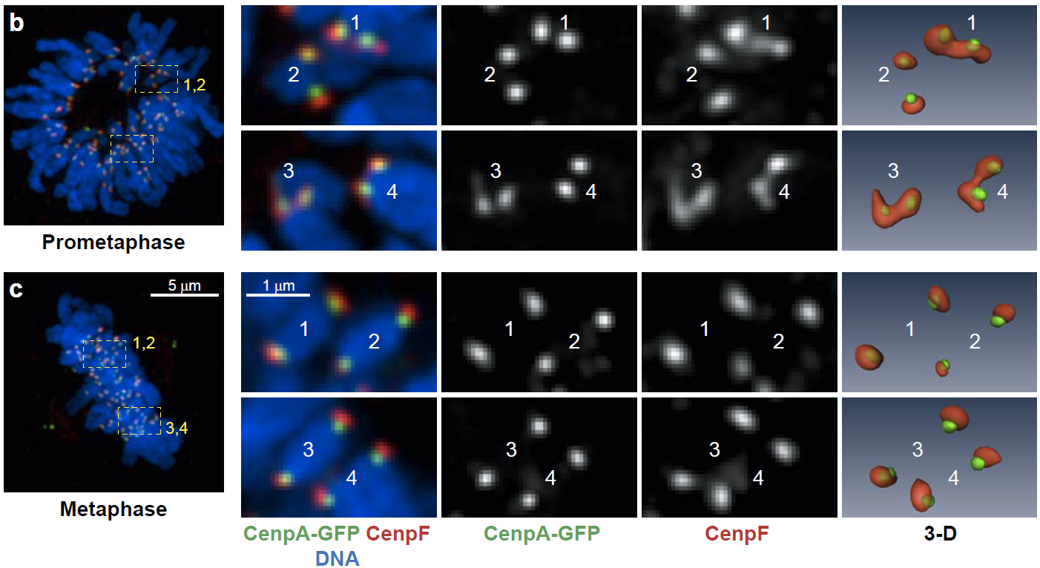
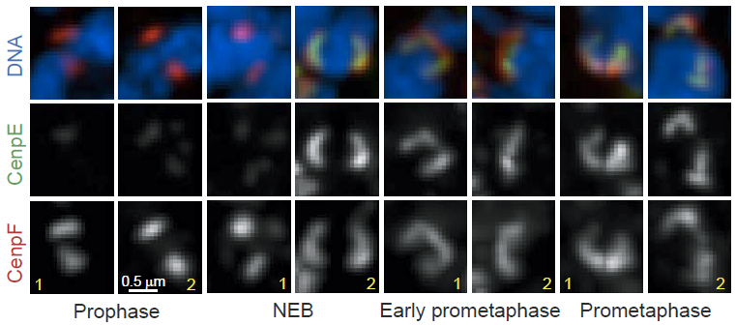
KT outer layers are enlarged in early prometaphase but compact later
Serial-section EM
LM

Slide 32
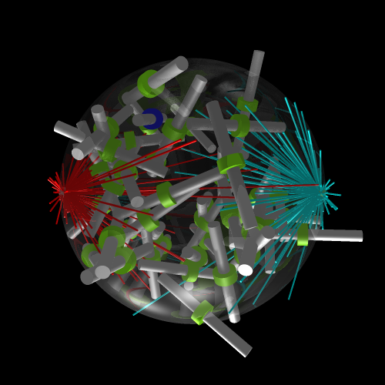
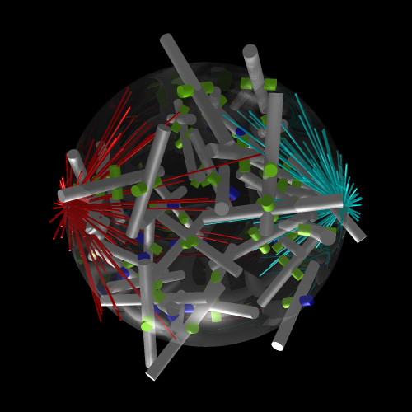
We can simulate the search-and-capture process
with different geometries

Slide 33
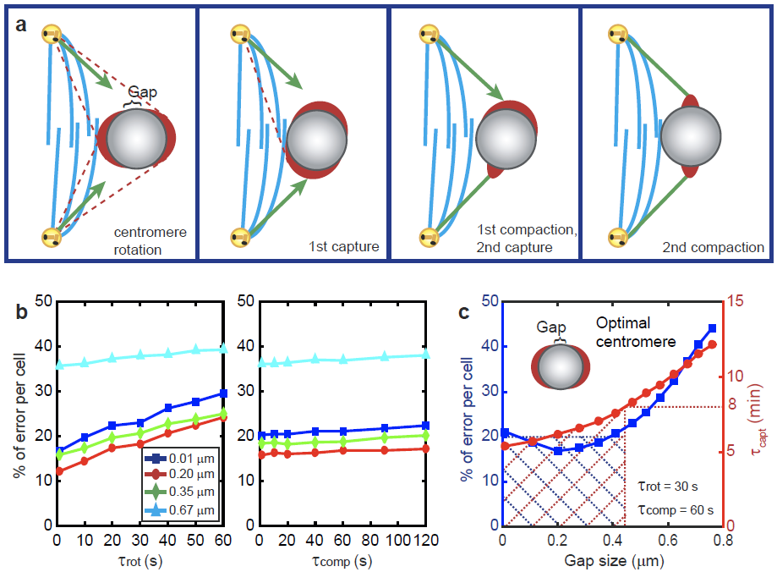
Rotation coordinated with MT-KT lateral attachment achieves both speed and accuracy together for large KTs

Slide 35
1/eps term is there because velocity is supposed to adjust to a steady state very fast

Slide 38
Let us try simplest boundary conditions on [-1,1]: u(-1)=u(1)=0. (For m, always no flux b.c.
For now, the cell is not moving.)
- Steady state. Stable?
Linear stability analysis

Slide 40
The first mode to break stability corresponds to q = π/2, so the criterion for instability is:
Two interesting limiting cases: 1) if zeta is big enough, then mu has to be very small, and
2) if D is very small and zeta is moderate, as is usually the case, then the 2nd term in the
bracket is much greater than 1, and

Slide 41
I solved the system numerically in 1D, and found that numerics completely confirms
the linear stability analysis. Also, note the following interesting dependence on b.c.:
B.C. for velocity: 1) U = 0 at the boundary 2) no flux at the boundary
Why the difference?

Slide 42
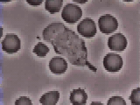
http://www.youtube.com/watch?v=JnlULOjUhSQ
Neutrophil fans’ comments:
hehe, funny.. GO WHITE CELL!
god dam the white blood cell dont give up easy
lol get the wee buggers
thats right bitch thats our immune system
haha..haha...get em.get em!
IMMUNE SYSTEM FOR THE WIN BITCH!!!
and dont you ever come in my body BITCH!!!!
YEAH YOU BETTER RUN YOU LITTLE BITCH
Deep social dialogue with an insight on hygiene:
As a liberal I am offended by this video.
The bacteria is obviously the minority and
on top of that it's black. Then the big powerful
WHITE blood cell comes along and strikes at
the poor bacteria. Unable to defend itself the
bacteria succumbs to whitey. We need to make
a change. Wake up America! You say there is
nothing 'you' can do, well that just isn't true.
Simply stop washing your hands and taking
showers regularly, then these poor bacteria may
have a fighting chance.
The bacteria is YELLOW, not black, dumbass!
Bacteria fans’ comments:
noooooooooo poor bacteria
Serious thoughtful scientific comments:
If two white cells are near one bacteria, do they
fight over each other to eat that bacteria?
there are 7000 to 25000 of these white blood cells
blob monsters in each drop of my blood.... I am invincible!
wow is this real!!! or is it made on a computer?

Slide 43
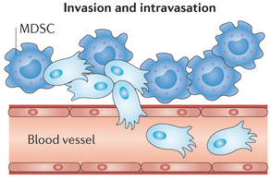
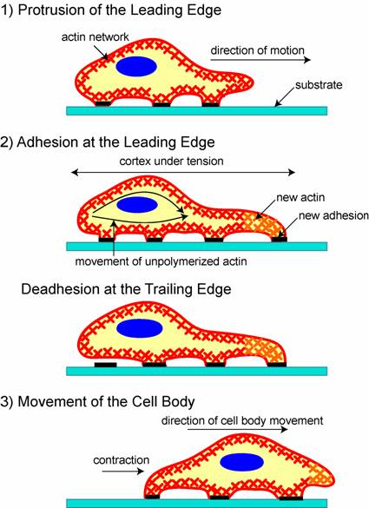
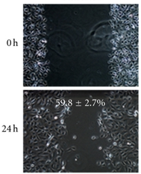
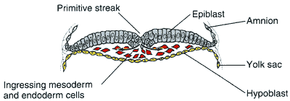
Steps of Cell Migration
Metastasis
Wound healing
Development

Slide 44



Polarization (symmetry breaking) and motility initiation
Movie: Yam, Theriot et al
Motile cells-
fan-shaped lamellipodium with cell body at the back
Stationary cells-
circular lamellipodium with cell body at the center
Spontaneous transition

Slide 45

Mechanical model of contractile viscous actin gel
Barnhart et al, PNAS (2015)
Barnhart et al, PLoS Biology (2011)
Wolgemuth et al, Biophys J (2011)
Rubinstein et al, Biophys J (2009)

Slide 46

The model predicts the myosin and flow distributions
Barnhart et al, PNAS (2015)

Slide 47


Distributions of flow and myosin in motile and stationary cells
Barnhart et al, PNAS (2015)

Slide 48

Free-boundary simulations
Barnhart et al, PNAS (2015)

Slide 49

The model suggests that <actin flow – myosin>
feedback alone is sufficient for polarization in principle
but alone is not enough
Barnhart et al, PNAS (2015)
adhesion myosin flow

Slide 50

Adhesion is stronger in stationary cells
and is not uniform across the cell
Low traction --- Fast flow
Barnhart et al, PNAS (2015)
High traction --- Slow flow

Slide 51


Hypothesis: negative feedback between actin flow and adhesion
Barnhart et al, PNAS (2015)
Gardel, Waterman-Storer et al
fibroblast
Traction stress (Pa)
keratocyte
theory
experiment
Actin speed (μm/s)

Slide 52

Free boundary simulation
Barnhart et al, PNAS (2015)
Traction forces

Slide 53

Rotation in the free boundary model

Slide 54



Key asymmetries in internal organization:
Allen et al, Submitted
Allen et al, Submitted
Myosin density and actin flow
are higher at the fast side,
but
traction forces are
higher at the slower side

Slide 55


Experimental trajectories
Theoretical prediction

